Slide 1
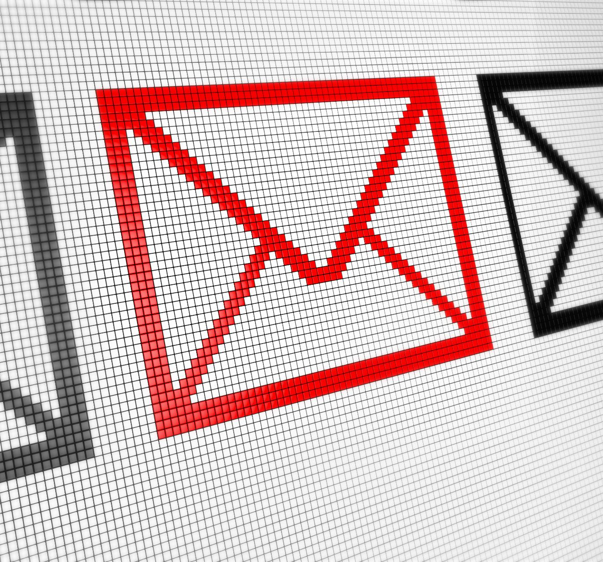
Phishing Awareness Training
Understanding and preventing deceptive cyber attacks
Notes:
AI-generated content may be incorrect. ---

Slide 2
Understanding Phishing and Its Forms
Notes:
What Is Phishing and How It Works, Common Email Phishing Techniques, Targeted Spear Phishing Attacks

Slide 3

What Is Phishing and How It Works
Phishing Defined
Phishing is a cyberattack that deceives individuals into revealing sensitive information via disguised malicious messages.
Psychological Exploitation
Phishing exploits trust, urgency, fear, and curiosity to prompt quick, uncritical responses from targets.
Sophisticated Tactics
Modern phishing uses personalized data and visual imitation to create credible and targeted attacks.
Consequences and Prevention
Phishing leads to credential theft and system breaches; prevention depends on technology and user awareness.
Notes:
Phishing is a deceptive cyberattack technique designed to trick individuals into divulging sensitive information, such as passwords, bank details, or personal identifiers, by disguising malicious communications as trustworthy ones. At its core, phishing exploits human psychology—particularly trust, urgency, fear, and curiosity—to prompt quick, uncritical responses. These attacks often mimic legitimate brands, organizations, or acquaintances, making them appear credible and increasing the likelihood of user interaction. For example, attackers may send emails that resemble official notices from banks, claiming unauthorized activity and urging the recipient to log in using a fraudulent link. Another common tactic involves impersonating workplace administrators, requesting verification of account credentials for system maintenance. Phishing messages frequently incorporate alarming language—such as threats of account closure or missed payments—to elicit emotional reactions that override rational decision-making. Visual imitation, including logos, color schemes, and formatting, further strengthens the illusion of authenticity, making detection more challenging for unsuspecting users. Modern phishing attacks have grown increasingly sophisticated; some include personalized details gathered from social media or breached databases, creating targeted messages known as spear phishing. Attackers may also combine phishing with malware delivery, embedding malicious attachments designed to compromise devices when opened. Once a victim interacts with a phishing communication—whether by clicking a link, downloading an attachment, or replying with information—the attacker can steal credentials, access systems, deploy ransomware, or commit identity fraud. Because phishing remains one of the most widespread and successful attack vectors globally, its prevention relies not only on technological measures but also on cultivating user awareness. Understanding how phishing operates empowers individuals to critically evaluate suspicious messages and reduces the effectiveness of social engineering tactics.

Slide 4

Common Email Phishing Techniques
Spoofed Sender Addresses
Attackers create sender addresses similar to real domains with subtle changes to deceive recipients.
Deceptive Hyperlinks
Phishers embed links that appear legitimate but redirect users to fraudulent websites to steal credentials.
Malicious Attachments
Attachments like infected PDFs or Word files with macros can compromise user devices when opened.
Psychological Manipulation
Phishing emails use urgent or threatening language to pressure recipients into immediate action.
Notes:
Email phishing is the most prevalent form of phishing, leveraging fraudulent emails disguised as legitimate communications to deceive recipients into taking harmful actions. Attackers often impersonate well‑known organizations such as banks, e-commerce platforms, or internal corporate departments to create a false sense of trust. These emails typically contain compelling narratives—such as security alerts, unrecognized login attempts, invoice notifications, or package delivery updates—that prompt users to click malicious links or download harmful attachments. One common technique is the use of spoofed sender addresses, which closely resemble real domains but include subtle alterations, such as swapped letters or added characters, making them difficult to distinguish at first glance. Phishers also embed deceptive hyperlinks that appear legitimate but redirect users to fraudulent websites designed to capture login credentials or financial information. Another method involves attachments containing malware, such as infected PDFs or Word documents with malicious macros; opening these files can compromise a user’s device, enabling unauthorized access or data theft. Email phishing campaigns also employ psychological manipulation, using urgent or threatening language—for example, claims of account suspension unless immediate action is taken. Attackers may also mimic corporate tone and formatting, including logos and footers, making their messages seem authentic. Some phishing attempts incorporate personalization using publicly available data, which increases user trust and heightens the likelihood of engagement. Recognizing these indicators—suspicious senders, unexpected requests, mismatched URLs, and grammatical inconsistencies—is essential for identifying email phishing attempts. Continuous employee training, combined with secure email gateways and spam filters, forms a critical defense strategy. Understanding these tactics equips users to remain vigilant, avoid falling victim, and contribute to a stronger organizational security posture.

Slide 5
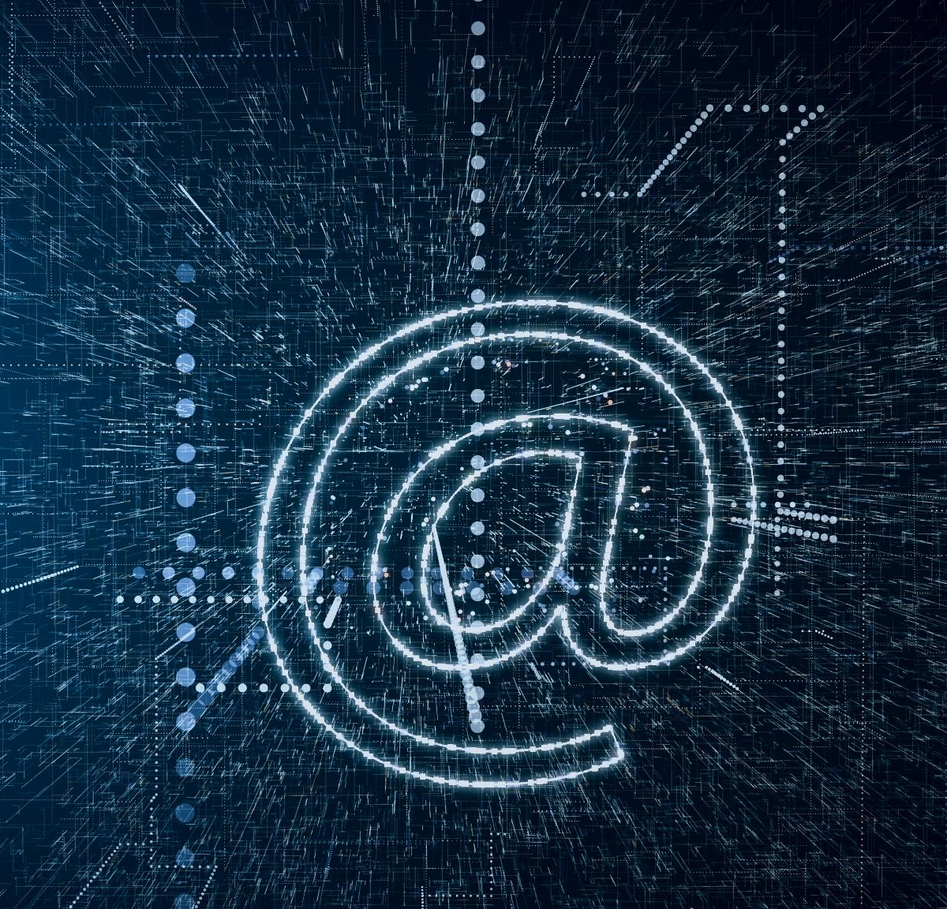
Targeted Spear Phishing Attacks
Personalized Attack Techniques
Spear phishing uses personalized details like job titles and roles to increase message credibility and success rates.
Business Email Compromise
Attackers impersonate executives or colleagues to request sensitive info or fraudulent transactions.
Malicious Attachments
Spear phishing emails often include malicious attachments disguised as invoices or purchase orders.
Defense Strategies
Implement multi-factor authentication, financial verification, and employee training to reduce spear phishing risks.
Notes:
Spear phishing is a highly targeted form of phishing that focuses on specific individuals, departments, or organizations rather than broad, mass‑distributed messaging. Unlike generic phishing emails, spear phishing attacks often incorporate personalized details—such as job titles, recent activities, organizational roles, or professional relationships—to increase credibility and likelihood of success. Attackers frequently gather this information from public sources, including LinkedIn profiles, company websites, social media posts, and leaked databases. Because these messages appear tailored and contextually relevant, victims may be more inclined to trust them and overlook warning signs. Spear phishing is commonly used in business email compromise (BEC) schemes, where attackers impersonate executives or trusted colleagues to request sensitive information or authorize fraudulent financial transactions. For instance, an attacker posing as a CEO might urgently request a wire transfer, citing confidential circumstances to prevent verification. Another variant involves attackers compromising one legitimate account and using it to target other employees, further amplifying trust. These attacks may also include malicious attachments—like invoices or purchase orders—that appear directly connected to ongoing business operations. Spear phishing poses a severe threat due to its precision and potential impact, often serving as an entry point for data breaches, ransomware deployment, or corporate espionage. Organizations must implement layered defenses, including multi-factor authentication, strict financial verification procedures, and continuous employee awareness training focused on identifying anomalies even in seemingly authentic communications. It is essential for individuals to critically evaluate unexpected requests, verify identity through alternate channels, and avoid sharing credentials under any circumstance. By recognizing the tailored nature of spear phishing, users can remain alert to subtle irregularities and significantly reduce the effectiveness of such attacks.

Slide 6
Modern Phishing Vectors and Prevention Strategies
Notes:
Smishing and Vishing Threats, Recognizing Signs of Phishing Attempts, Best Practices to Stay Safe from Phishing

Slide 7

Smishing and Vishing Threats
Smishing Explained
Smishing uses deceptive SMS messages to trick users into clicking malicious links or revealing sensitive information.
Vishing Tactics
Vishing employs fraudulent phone calls with spoofed caller IDs to pressure victims into sharing confidential data.
Prevention Strategies
Avoid clicking suspicious links, verify requests independently, and use call-filtering tools to protect against attacks.
Notes:
Smishing and vishing represent two increasingly common phishing methods that exploit mobile communication channels: SMS text messages and voice calls. Smishing, short for SMS phishing, involves attackers sending deceptive text messages that often impersonate banks, delivery services, or governmental agencies. These messages typically urge immediate action, such as clicking a link to verify account details, claim a refund, or track a package. Because SMS interfaces display limited information, users may find it more difficult to inspect sender details or link authenticity, making smishing particularly effective. Attackers frequently use shortened URLs to obscure malicious links, further reducing user suspicion. Vishing, or voice phishing, operates through fraudulent phone calls, often leveraging automated voice systems or live impersonators pretending to represent financial institutions, tech support teams, or even law enforcement. These callers may pressure victims by claiming suspicious account activity, legal issues, or urgent technical problems requiring immediate access to devices or accounts. Some vishing operations use caller ID spoofing to display legitimate‑looking numbers, enhancing credibility. Both smishing and vishing rely heavily on social engineering tactics, including urgency, fear, and authority impersonation, to manipulate victims into sharing sensitive data. Preventing these attacks requires heightened awareness and critical evaluation of unsolicited messages or calls. Users should avoid clicking links in unexpected messages, refrain from responding to requests for credentials, and independently verify claims by contacting organizations through official channels. Enabling call‑filtering tools, blocking suspicious numbers, and educating individuals about common scams increase overall protection. Together, understanding how smishing and vishing operate helps individuals recognize red flags and maintain security across multiple communication platforms.

Slide 8
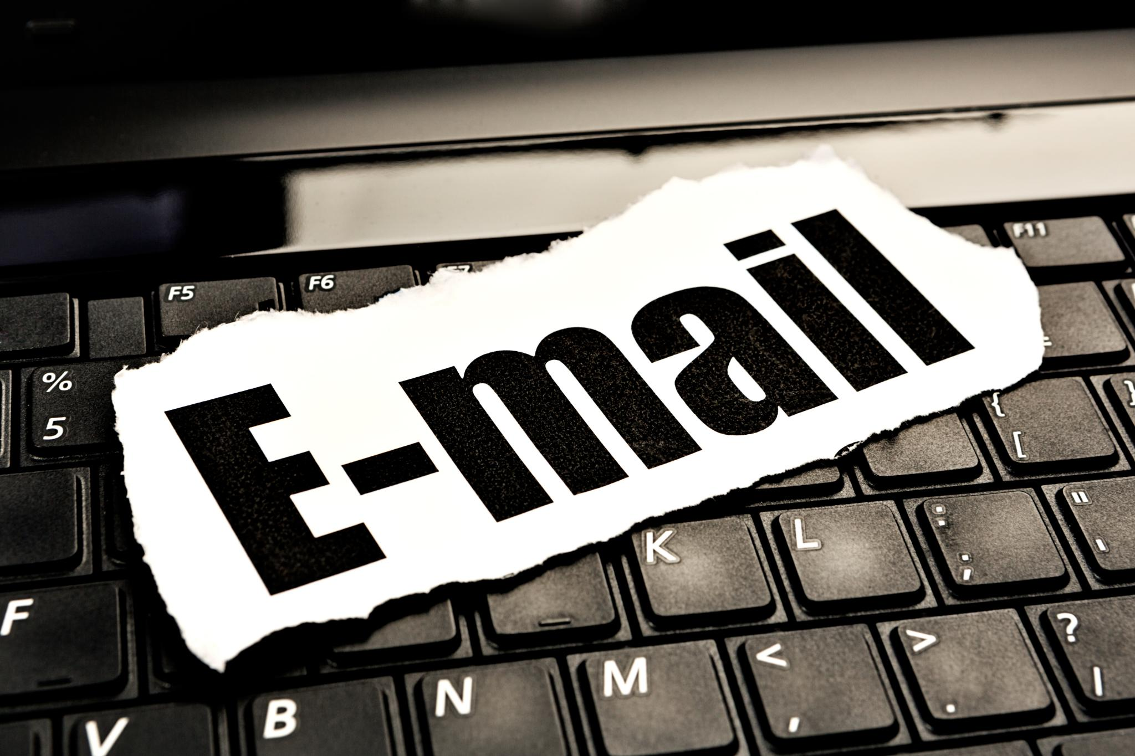
Recognizing Signs of Phishing Attempts
Suspicious Sender Addresses
Phishers use spoofed or slightly altered email addresses to trick recipients into trusting fraudulent messages.
Poor Grammar and Formatting
Phishing emails often contain spelling mistakes and awkward phrasing that indicate unprofessional origins.
Suspicious Hyperlinks
Hovering over links can reveal mismatched URLs indicating malicious intent behind phishing attempts.
Emotional Manipulation and Urgency
Phishing messages often use urgent language to provoke quick, unthoughtful responses from recipients.
Notes:
Identifying phishing attempts requires a careful assessment of message content, sender details, formatting, and contextual cues. One of the most reliable indicators is an unexpected or suspicious sender address—phishers often spoof email domains or use addresses that closely resemble legitimate ones but contain minor alterations, such as extra characters or spelling inconsistencies. Another common sign is poor grammar, spelling mistakes, or awkward phrasing, which can signal a lack of professionalism typical of fraudulent communications. Users should also scrutinize hyperlinks by hovering over them before clicking to reveal the true destination URL; mismatched or unrelated domains are a strong sign of malicious intent. Phishing messages frequently rely on emotional manipulation, using urgent or threatening language intended to provoke immediate action—for example, warnings of account suspension, security breaches, or financial penalties. Additionally, requests for sensitive information such as passwords, one-time passwords (OTPs), or banking details should always be treated as red flags, as legitimate organizations rarely solicit such data through email or messaging platforms. Visual inconsistencies, such as distorted logos or unusual formatting, may also indicate fraudulent origins. Attachments from unknown sources, particularly executable files or documents requiring macro enabling, pose significant risk and should be approached cautiously. Recognizing phishing requires understanding these signals and maintaining vigilance, especially when handling communications involving financial accounts, workplace systems, or personal data. Developing a habit of verifying unexpected requests through official contact points can significantly reduce susceptibility to phishing. Furthermore, reporting suspicious messages to relevant IT or security teams enhances collective defense and helps organizations track emerging threats.

Slide 9
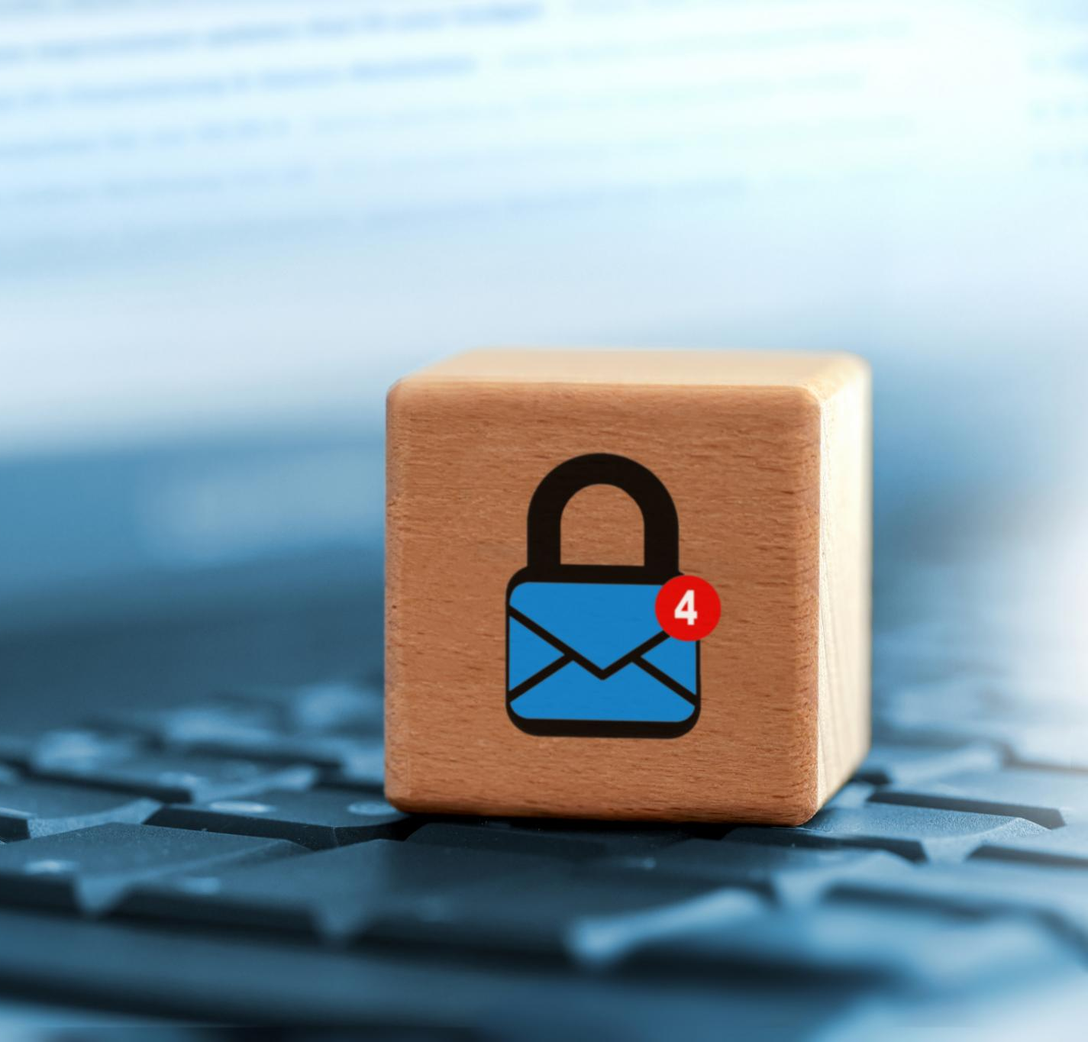
Best Practices to Stay Safe from Phishing
Multi-Factor Authentication
Enabling MFA adds an extra verification layer to protect accounts even if credentials are compromised.
Link Verification Habits
Always verify links in unsolicited messages by checking domain names or hovering over hyperlinks before clicking.
Avoid Sharing Sensitive Information
Never share passwords, OTPs, or banking details over email, SMS, or calls as legitimate organizations avoid such requests.
Continuous Cybersecurity Awareness
Routine training and simulated phishing exercises improve recognition and response to phishing attempts.
Notes:
Staying safe from phishing requires a combination of awareness, protective practices, and the adoption of security technologies that work together to reduce risk. One of the most effective defenses is enabling multi-factor authentication (MFA), which adds an extra verification layer even if an attacker manages to obtain login credentials. Users should make it a habit to verify links before clicking, particularly in unsolicited emails or text messages, by checking for inconsistencies in domain names or hovering over hyperlinks to view their true destination. It's also essential to avoid sharing sensitive information—such as passwords, OTPs, and banking details—over email, SMS, or phone calls, as legitimate organizations rarely request such data through insecure channels. Regularly updating software and using reputable antivirus tools can help detect and block malicious payloads delivered through phishing attempts. Employing spam filters and secure email gateways reduces the number of phishing emails reaching inboxes in the first place. Organizations should encourage a culture of cybersecurity awareness through routine training and simulated phishing exercises, helping individuals practice recognition and response skills in realistic scenarios. Users should also verify suspicious communications by contacting the supposed sender through official channels, never relying solely on the information provided in the potentially compromised message. Reporting phishing attempts to IT or cybersecurity teams supports broader organizational protection and helps track ongoing threat campaigns. Ultimately, combining technical safeguards with informed behavioral practices creates a resilient defense that significantly reduces vulnerability to phishing attacks.

